Slide 1

CYCLISTIC
BIKE-SHARE
Case Study - Google Data Analytics Capstone Project
August 02, 2021
Presented By - Sakshi Paliwal

Slide 2
CONTENTS
Introduction
Business Task
Data Visualization
Summary
Recommendations

Slide 3
INTRODUCTION
About the company
In 2016, Cyclistic launched a successful bike-share offering. Since then, the program has grown to a fleet of 5,824 bicycles that are geotracked and locked into a network of 692 stations across Chicago. The bikes can be unlocked from one station and returned to any other station in the system anytime.

Slide 4
BUSINESS
TASK
How do annual members and casual riders use Cyclistic bikes differently?

Slide 5
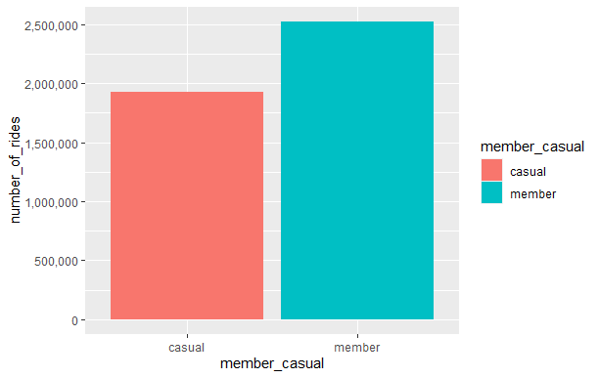
INSIGHT #1
Total No. Of Rides are higher in Member category than Casual Riders.
Number of Rides in 12 months (Member vs Casual))

Slide 6
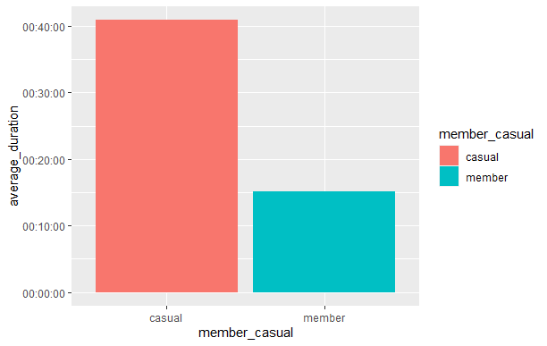
INSIGHT #2
Average duration of rides are higher in Casual category than Members.
Average Duration of 12 months (Member vs Casual))

Slide 7
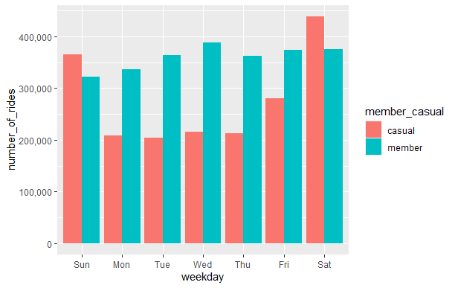
Number of Rides during the week (Member vs Casual))
INSIGHT #3
Members category contributed throughout the week, however Casual riders have contributed mostly on Saturdays and Sundays

Slide 8
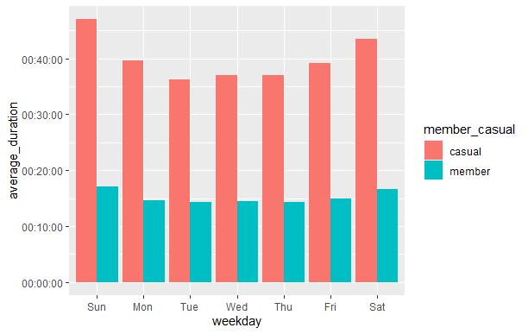
Average Duration during the week (Member vs Casual)
INSIGHT #4
Casual riders fluctuates throughout the week while Member riders are constant throughout the week

Slide 9
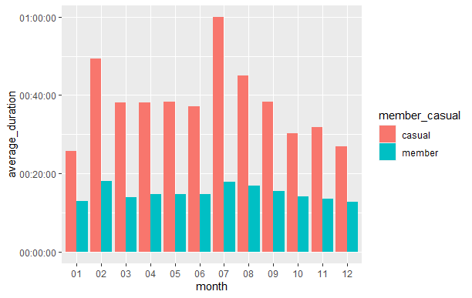
Number of Rides by Month (Member Vs Casual)
INSIGHT #5
Casual riders peaked in the month of July and Feb.

Slide 10
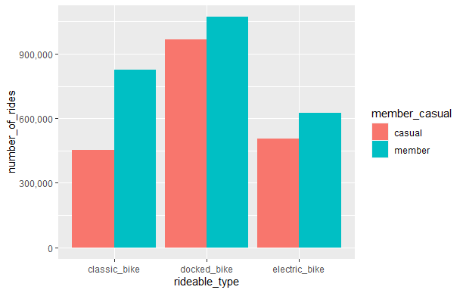
Number of Rides by Type of Bikes (Member Vs Casual)
INSIGHT #6
Docked Bikes are most used by both casual and member riders.

Slide 11
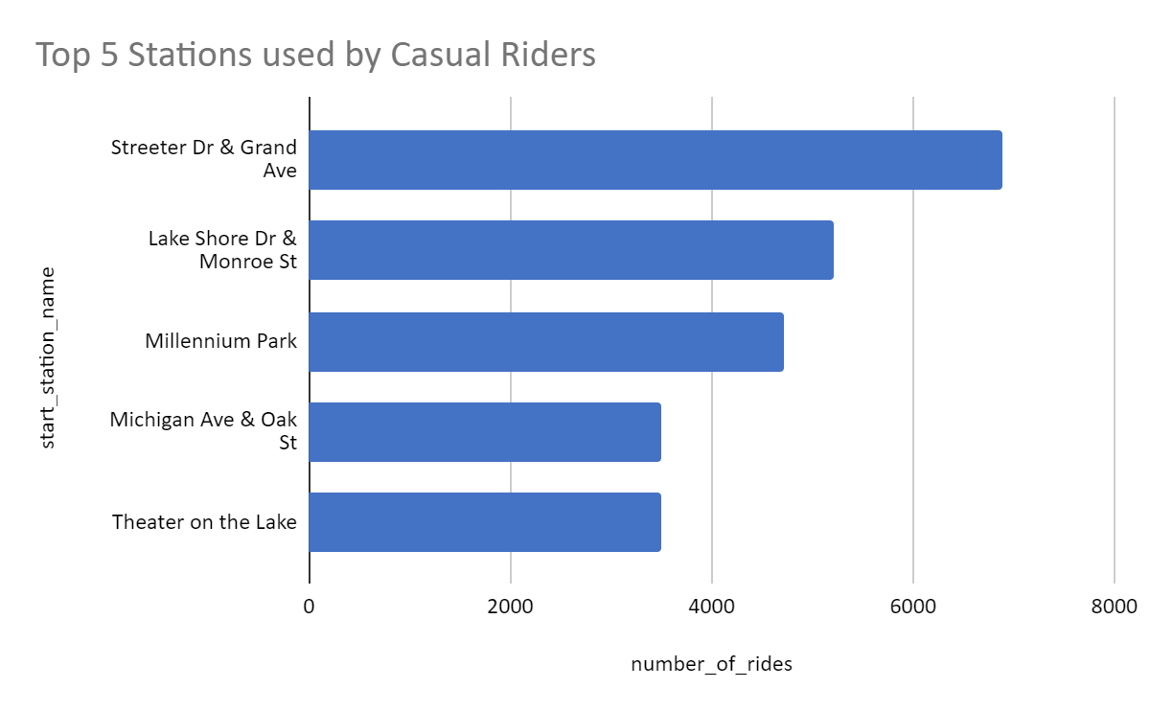
INSIGHT #7
Most used stations by casual riders.

Slide 12
SUMMARY
Members are taking more no. of rides than casual riders, however average duration of rides are high in casual riders.
Members are active and taking rides throughout the week, however casual rides are more active on weekends.
Average Duration of rides are constant for members during the week, however casual riders are fluctuating with average duration during the week.
Casual riders peaked in the month of “July” and “Feb”
Docked Bikes are more popular and used by both member and casual riders.
Top 5 Stations - Streeter Dr & Grand Ave, Lake Shore Dr, Millennium Park, Michigan Ave & Oak St and Theatre on the Lake.

Slide 13
RECOMMENDATIONS
The marketing team should work on the membership offers at cheaper or discounted rate on targeted riders.
Design seasonal membership packages to allow flexibility rather emphasizing on annual membership.
Offers or designed packages to be announced in summer months or weekends when casual riders are more active.
Marketing campaigns to be targeted at most busiest stations used by casual riders.

Slide 14
THANK YOU

